Slide 1
jBLoader Overview

Slide 2
What Is jBLoader?
A data loading / ETL tool used to transfer data between systems.
specifically designed to extract data from T24 core banking databases (Temenos) and load it into various relational databases
JBLoader is a powerful, automated data extraction tool that acts as a bridge between the Transact database and your bank’s reporting and analytics tools.
It supports various data formats such as CSV, XML, and JSON, making it adaptable to your institution’s data processing requirements.
JBLoader's remarkable ability to extract and normalize millions of records quickly, without burdening the source database, sets it apart as an industry-leading solution.

Slide 3
What data is inside T24 database?
T24, is a leading, comprehensive, and modular core banking system used by financial institutions worldwide to manage front- to back-office operations. It provides real-time processing for services such as retail banking, lending, treasury, and payments. Synonyms include Temenos Transact, T24 Core Banking, and formerly, Globus
Examples and Functions of T24:
Core Banking Operations: Managing deposit accounts, loans, and customer records.
Real-time Transactions: Processing payments, funds transfers, and currency exchanges instantly.
Customization: Implementing tailored modules for specific needs like Islamic banking, trade finance, or wealth management.
Digital Integration: Using open APIs to connect with mobile apps and third-party fintech solutions.
Compliance and Risk: Enabling KYC (Know Your Customer) and AML (Anti-Money Laundering) checks.

Slide 4





COMPANY OVERVIEW

Slide 5
What is happening through an extraction process
Home screen
Administration
Configuration
Migration
Metadata Selection
Reports & Statistics
Technical Information

Slide 6
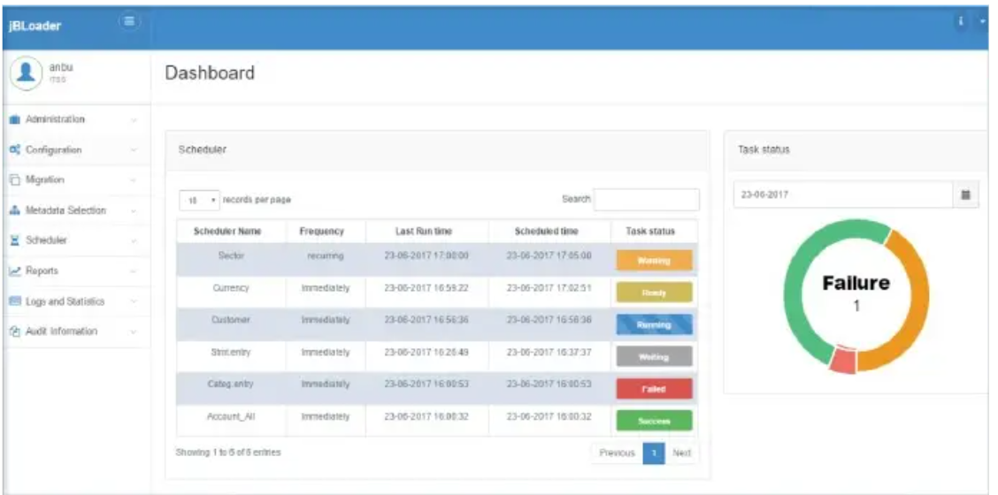
Home screen
The landing page of jBLoader will have a list of menus and a dashboard that holds a summary of the status for the tables being extracted and the list of configured schedulers along with their status

Slide 7
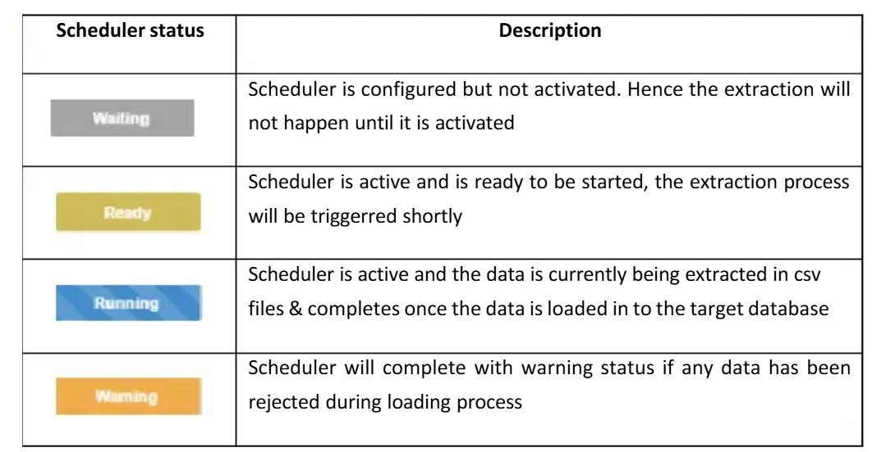
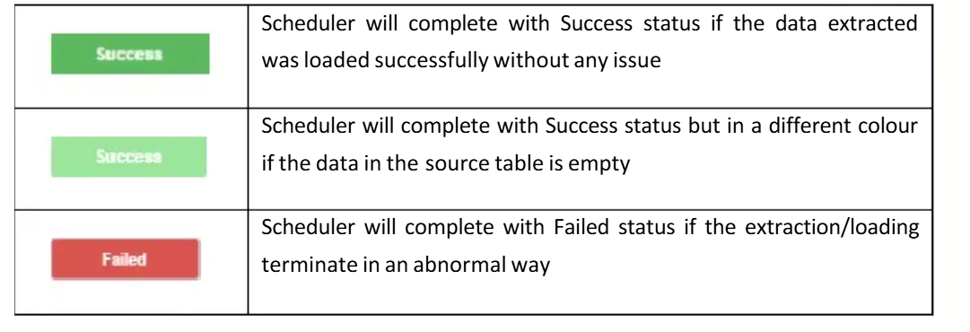
scheduler (task) status summary

Slide 8
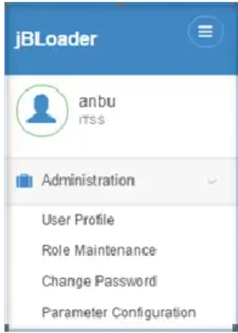
administration
The administration menu is used to control jBLoader users, i.e., to restrict access to the jBLoader application based on user usability, and also to configure the basic details required for the application

Slide 9
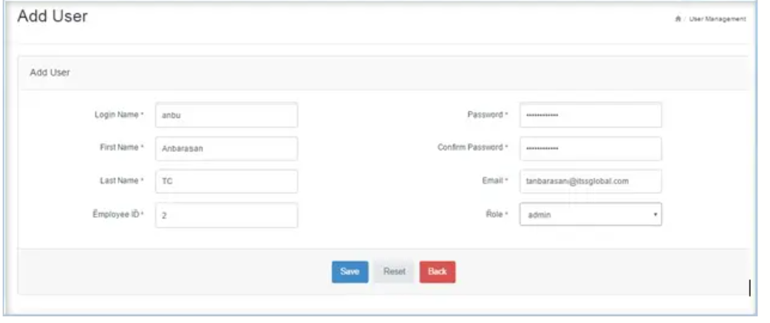
User Profile
A new user can be set up based on the role assigned to them to use the application. This role can be changed at any time if the administrator wants to restrict access.
An email ID needs to be configured; this will be used while resetting their password.

Slide 10
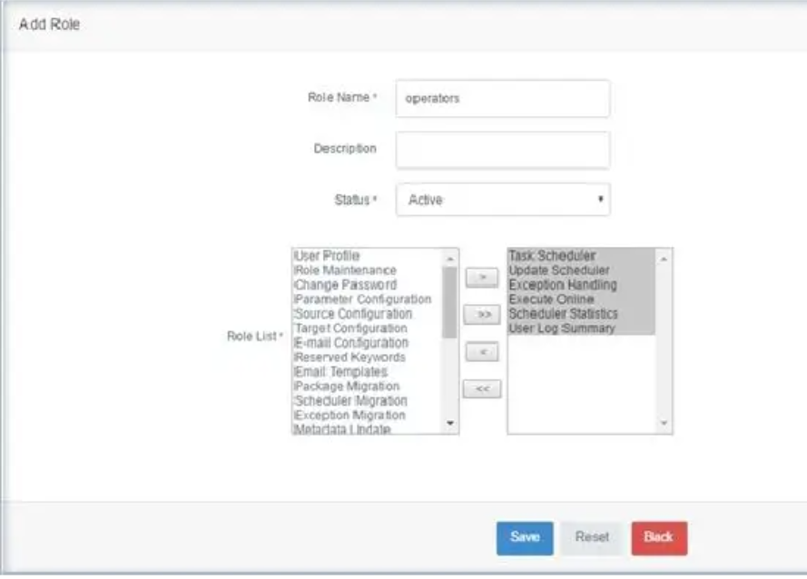
Role Maintenance
The user access to the menu will be restricted at the role level. A role can be set up and the required access to the menus will be assingned to it. So that the user can access only those menus and the other menus will not be visible in their login

Slide 11
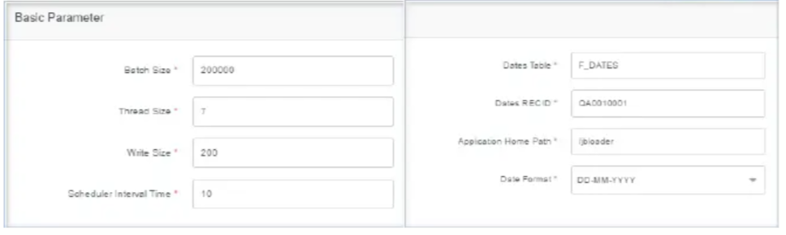
Parameter Configuration
It holds the default configuration based on various criteria that will be used for the extraction
Basic Parameter
Batch size: Number of records that will be extracted per CSV file (Default: 200,000)
Thread size: Maximum number of threads used during extraction for a single table (Default: 7)
Write size: Defines the sizes to be written for the number of column tags parsed (Default: 200)
Scheduler interval time :Interval time for the scheduler to monitor any change in the scheduler status to trigger the extraction process (Time in secs)
Dates Table: The actual table name in the source database for the DATES table. This is used to have the current 124 date in all the extracted records in the target database.
Dates RECID: The default record ID of the DATES table from the source database.
Application home path:The home path of the jBLoader application available on the server. All the necessary logs and the required license will be available here

Slide 12
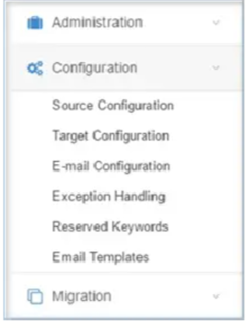
Configurations
All the major configurations regarding the extraction will be available under this menu. The source database details (from where data will be extracted) and its corresponding application server details, if required, target database details (data will be stored), email setup, and data exception handling will be configured here

Slide 13
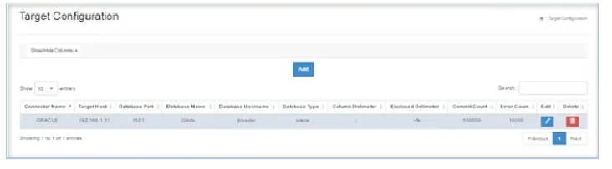
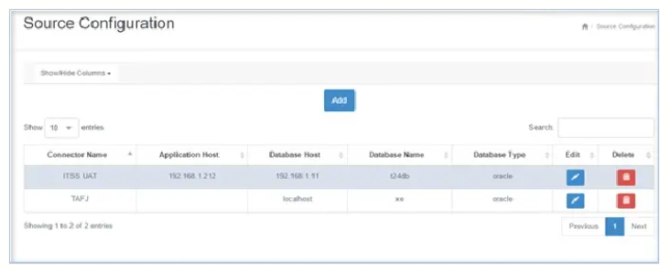
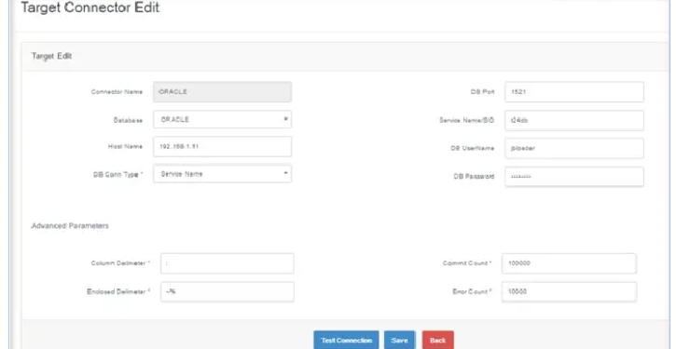
1. Source Configuration
Settings for the source system/database where data comes from.
Examples:
Source server name
Database name
Username/password
Port
Connection type
Meaning: Where jBLoader reads data.
2. Target Configuration
Settings for the target system/database where data will be loaded.
Examples:
Oracle / SQL Server connection
Target table names
Credentials
Meaning: Where jBLoader stores data.

Slide 14
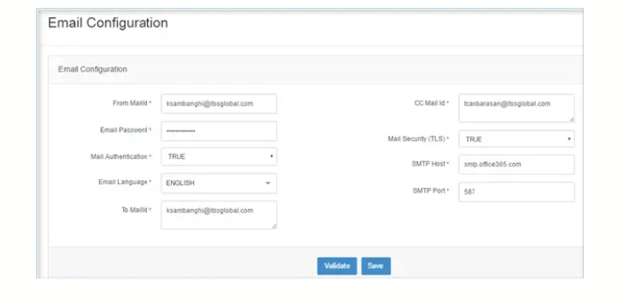
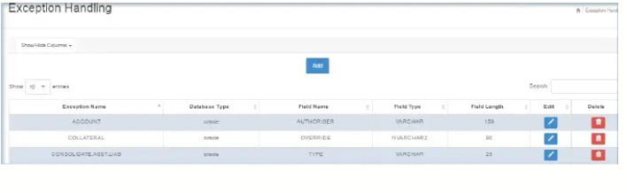
3. Email Configuration
Settings for email notifications.
Examples:
SMTP server
Sender email
Recipient emails
Success/failure alerts
Meaning: Sends messages about jobs.
4. Exception Handling
Rules for handling errors or bad data.
Examples:
Skip invalid rows
Log errors
Stop job on failure
Retry process
Meaning: What the system does when something goes wrong.

Slide 15
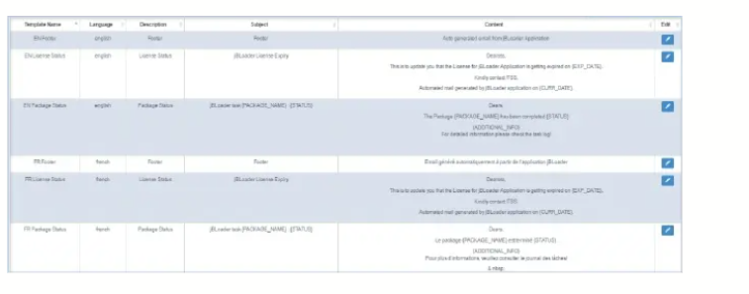
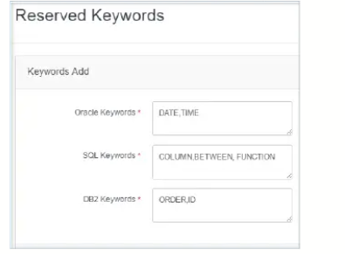
5. Reserved Keywords
Words that are special in databases/programming and should be handled carefully.
Examples:
SELECT
TABLE
ORDER
DATE
If a column name uses one of these, it may cause errors.
Meaning: Protected words used by system/database.
6. Email Templates
Predefined message formats for emails.
Examples:
Job success email
Job failure email
Warning email
Instead of writing every time, the system uses templates.

Slide 16
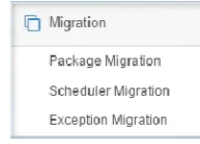
MIGRATION
For clients already using an older version of jBLoader, either the service version or the direct version, it is easy to migrate them to the jBLoader web-based version. The necessary components to be migrated from the older version are the packages, tasks, and exceptions.

Slide 17
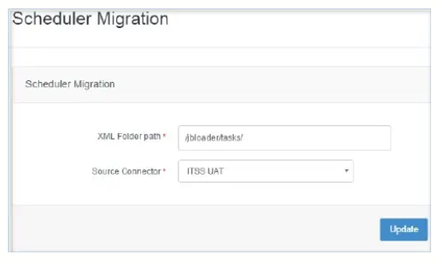
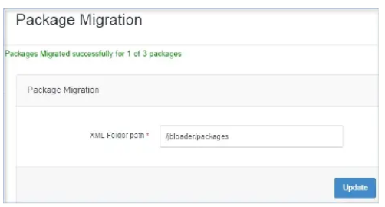
1. Package Migration
Packages usually mean grouped ETL jobs, extraction definitions, workflows, or deployment units.
Example:
Daily Finance Package:
Extract accounts
Load transactions
Send report
So package migration = move existing job packages into new version.
2. Scheduler Migration
Scheduler means job timings and automation rules.
Examples:
Run every day at 1:00 AM
Run every Friday
Run after another task finishes
Scheduler migration = keep old schedules in new system.

Slide 18
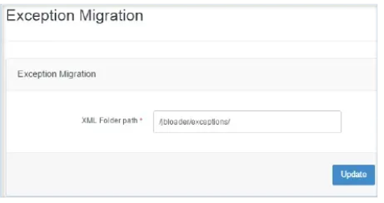
3. Exception Migration
Exceptions mean saved error handling rules or exception records.
Examples:
Skip duplicate rows
Log failed records
Notify admin on error
Exception migration = preserve those rules/history

Slide 19
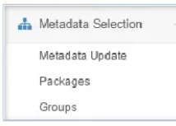
Metadata
This is the main section for extracting the table structure of all available tables in T24 and updating it in the local database. It also allows you to set up the required tables to be extracted and their corresponding fields.

Slide 20
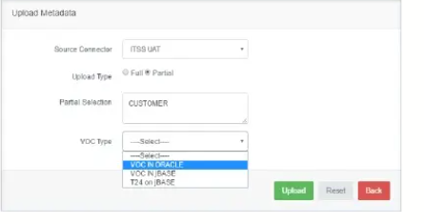
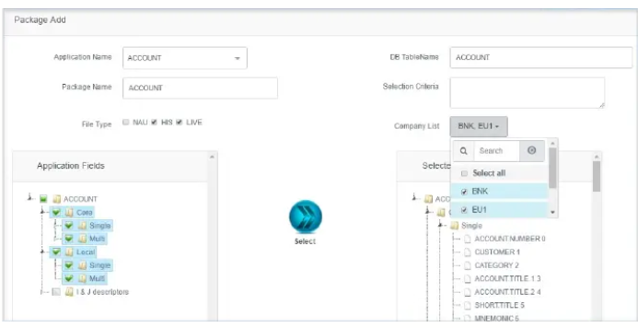
1. Metadata Update
Meaning:
Refreshing or synchronizing table structures from the source system (like Temenos T24) into jBLoader.
Why Needed:
If the source database changes, jBLoader must know.
Examples:
New table added
New column added
Column datatype changed
Field removed
Example:
T24 adds field EMAIL to CUSTOMER table. Metadata Update refreshes jBLoader so it can see that field.
Easy Answer:
Metadata Update keeps jBLoader aligned with the latest source database structure.
2. Packages
Meaning:
A package is a collection of related extraction/load tasks grouped together.
Instead of running many jobs separately, you run onepackage.
Example Package:
Daily Reporting Package
Extract CUSTOMER
Extract ACCOUNT
Extract TRANSACTION
Load reporting tables
Send completion email
Why Useful:
Better organization
Easier scheduling
One-click execution
Process dependencies
Easy Answer:
Packages are grouped jobs or workflows executed together.

Slide 21
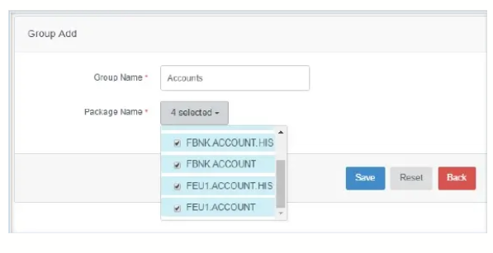
3. Groups
Meaning:
Groups are used to organize tables, packages, or tasks into categories.
Think of folders or departments.
Examples:
Finance Group
HR Group
Customer Group
Daily Jobs Group
Why Useful:
Easier navigation
Better management
Security/ownership by team
Cleaner administration
Easy Answer:
Groups help classify and organize extraction objects logically.

Slide 22
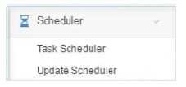
Scheduler
The Scheduler automates extraction jobs. Task Scheduler creates and manages jobs, while Update Scheduler changes existing timings, especially for multiple weekday tasks.

Slide 23
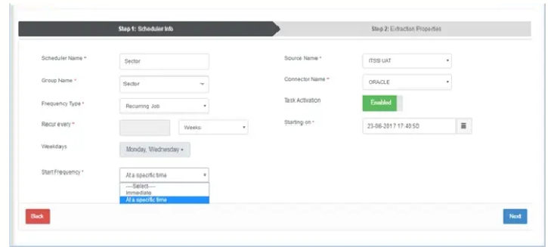
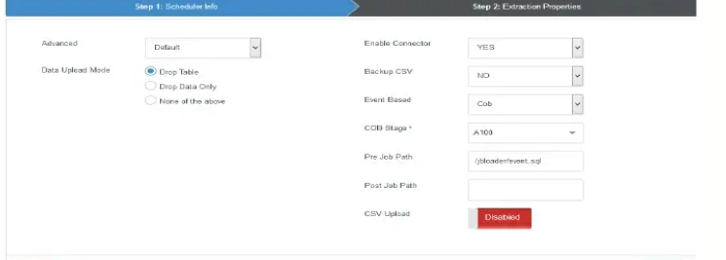
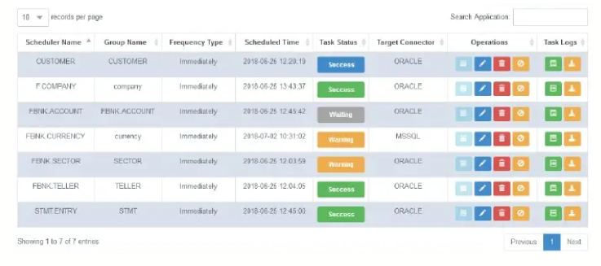
1. Task Scheduler
Meaning:
Where you create/manage scheduled tasks.
A task can be:
Extract CUSTOMER table
Run package
Load reporting DB
Send report email
Common Settings:
Job name
Start time
Frequency
Days to run
Enabled/disabled
Dependency rules
Example:
Task: Daily Transactions Load Time: 2:00 AM Days: Mon–Fri

Slide 24
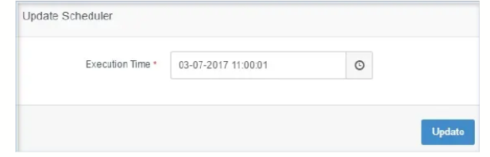
2. Update Scheduler
Meaning:
Used to modify existing schedules quickly.
Instead of editing each job one by one.
Examples:
Shift all weekday jobs by +1 hour
Change start time from 1 AM to 3 AM
Pause jobs temporarily
Update holiday timing

Slide 25
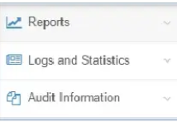
REPORTS & STATISTICS
Once configured and scheduled for extraction, we have an additional feature to generate basic reports with the extracted data. User log summaries and scheduler statistics are also available. Logs are maintained at the menu level, which is useful for audit purposes. Audit information is available for all menus, providing details on created, updated, and deleted data for all columns.

Slide 26
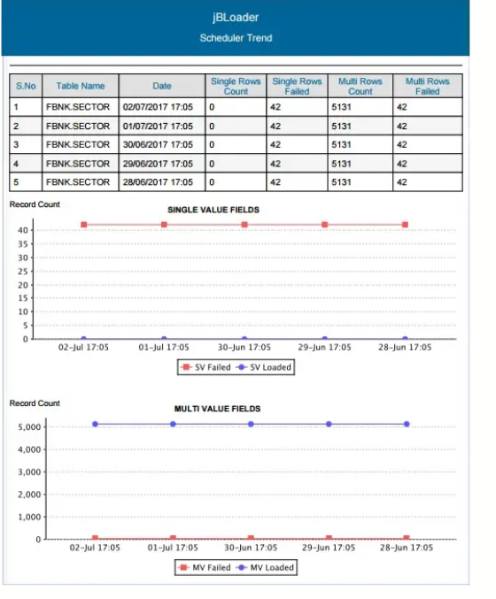
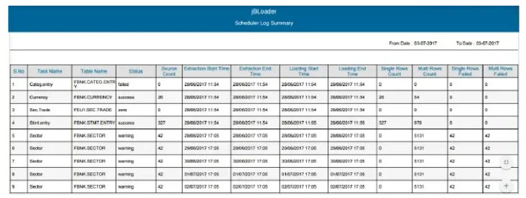
1.REPORTS
Graphical report
Static Report
By default, we have four static reports based on scheduler status and log summary for user activity and scheduler. It is also possible to filter the report by applying selection criteria with the available fields in the corresponding table used for reports. The user can also select the report format, such as PDF, CSV, and HTML.
A scheduler trend report is available in graphical view, in which the number of records loaded and rejected for a particular table can be viewed in a graph for the given range of dates.

Slide 27
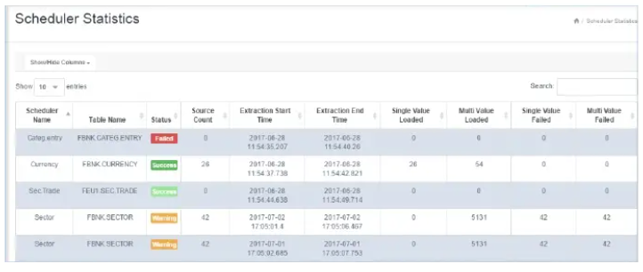
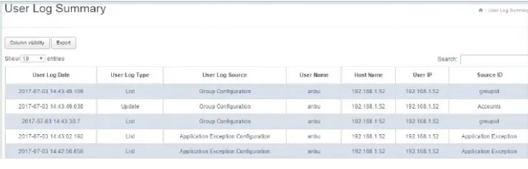
2.Logs and Statistics
Scheduler Statistics
User log summary
- All detailed logs regarding the scheduler, i.e., the number of records loaded for single-value and multi-value tables, extraction time, source count, and the scheduler's status are available from this menu
All user activities are captured and details regarding them are available. i.e., user activity (list, update, etc.) on the respective record at the menu level are available.

Slide 28
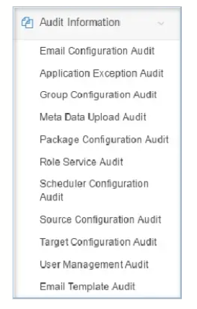
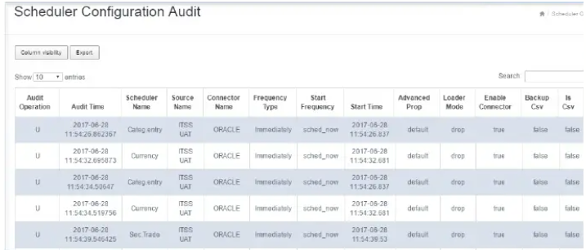
3.Audit Information
The logs captured at the menu level are used for audit purposes. All activities are logged, and the values updated for all available columns in the corresponding menu are displayed as audit information.
Audit details are available for the list of menus below
Below is the sample screenshot for the audit log for Scheduler configuration

Slide 29
TECHNICAL INFORMATION
This section explains how jBLoader works with Temenos T24 on the server side, how services start/stop, licensing, and troubleshooting.
A. When Extra Technical Setup Is Needed
B. jBLoader Uses T24 Services
C. License Requirement
D. Starting the Service
E. Stopping the ServiceSTOP
F. How Processing Works Internally
G. After Extraction Completes
H. Troubleshooting Section

Slide 30
A. When Extra Technical Setup Is Needed
Special setup may be required when:
1. Extraction Happens at Application Server Level
Meaning data is not pulled directly from DB only, but through T24 application services.
2. Oracle / T24 Special Fields Are Needed
Examples:
DESC
J-DESC
Virtual fields
These may not exist as normal DB columns and need server-side logic.
3. Special Selection Criteria Needed
Meaning advanced filters such as:
Only active customers
Only today’s transactions
Only specific branch records
B. jBLoader Uses T24 Services
jBLoader depends on T24 server-side services/objects to process extraction requests.
Important Service:
JBLOADER SERVICE CONTROL (text had spelling errors)
This service should usually be set to:
AUTO Meaning of AUTO: Runs automatically in background.
D. Starting the Service
If services were stopped earlier:
Step 1:
Clear status files (TSM status) so old sessions don’t block startup.
Step 2:
In T24 records:
Set:
JBL RUN SERVICE = AUTO
TSM = START
Step 3:
Authorize records
Step 4:
Run start command
Meaning services begin running in background.
C. License Requirement
Need valid license in:
JBLOADER PARAMETER-SYSTEM
Important fields:
LICENSE.CODE
MAINTENANCE DATE
Meaning:
Without valid license, tool may not run properly.

Slide 31
E. Stopping the Service
Go to service control screen and set:
STOP
Then authorize.
Meaning jBLoader background processing stops safely.
G. After Extraction Completes
When extraction finishes:
Output files are created
Files are transferred back to GUI
GUI loads them into target system/database
F. How Processing Works Internally
ELRUNSERVICE
This is a control service.
Its job:
Detect restart requests from GUI
Trigger extractor services
JBLEXTRACTORX
Actual extraction workers.
(X = service number like 1,2,3...)
They perform real data extraction.
Maximum Number of Services:
Up to 6 parallel services
Configured in:
JBLOADER PARAMETER → MAX SERVICE NUMBER
H. Troubleshooting Section
If Issue Happens from T24 Side:
Check JBLEXTRACTORX services.
These services handle two stages:
1. Extraction
Reads data.
2. Cleanup
Clears temp files
Creates ZIP file (if needed)

Slide 32
THANK YOU

